Slide 1
Profitability Analysis
CO-PA

Slide 2
Course Objectives
Understand the functions in Profitability Analysis.
Explain Profitability management in SAP.
Understand CO-PA structures and master data.
Identify the source of actual values.
Understand planning.
Use the CO-PA information system.

Slide 3
Table of contents
Course Map
Module 1: Overview
Module 2: Profitability Management
Module 3: Master Data
Module 4: Planning
Module 5: Actual data flow
Module 6: Information System

Slide 4

Profitability Analysis at A Grp
Profitability Analysis will enable A Grp to analyze the profitability of market segments according to the following characteristics:
  Products
  Customers
  Sales Districts (i.e. USA West,
  USA East, Saudi Arabia etc.)
  Others
Sales District
Customer
Product
Notes:
Profitability Analysis (CO-PA) enables A Grp to evaluate market segments, which can be classified according to product, customers, sales districts or any combination of these, or strategic business units, Business segment, Business field with respect to your company's profit or contribution margin (gross margin). It represents market-oriented approach.
The aim of the system is to provide your sales, marketing, product management and corporate planning departments with information to support internal accounting and decision-making.

Slide 5
CO Module Overview
CO
Profitability Analysis
EC
PA
How profitable are individual market segments?
PCA
Overhead Cost Controlling
CO
Product
How can we reduce our overhead?
Are the responsibility areas working efficiently?
How high are the organisational activity costs? Are they within their budgets?
How can we optimise our internal business processes?
PC
Cost
CO
Controlling
OM
What are the
Manufacturing
Costs of a product?
Profit Center Accounting
Overhead Cost Controlling
CO
How
CEL
What costs occur within the organisation?
Profitable are
Individual areas?
Notes:
Controlling provides you with information for management decision-making. It facilitates coordination, monitoring and optimization of all processes in an organization. This involves recording both the consumption of production factors and the services provided by an organization.
All data relevant to costs flows automatically from Financial Accounting to Controlling. As part of this process, the system assigns the costs and revenues to different CO account assignment objects like cost centers, business processes, projects, or orders. The relevant accounts in Financial Accounting are managed in Controlling as cost elements or revenue elements as appropriate.
How profitable are individual enterprise areas? Profit Center Accounting (EC-PCA) provides a focus on internal areas of a company that have responsibility for achieving certain profit or productivity goals.
Profitability Analysis (CO-PA) provides a focus on the results of a company’s doing business with the external marketplace. It provides the ability to define which aspects or segments of that market are relevant for analyzing operating results, such as profit by customer, product, geographic area, sales organization, etc.
You use Cost Center Accounting for controlling purposes within your organization. It serves as a tool for monitoring overhead costs and assigning them to the location at which they occurred in line with their source.
Product Cost Controlling calculates the costs arising from the manufacture of a product or the provision of a service. It enables you to calculate the minimum price at which a product can be profitably marketed.

Slide 6


Flow of actual values in Profitability Anal.
CO
PA
CO
CO
Profitability Analysis
Profit. segments
Profitability Analysis
Overhead Cost
Overhead Cost
Product Cost
Product Cost
Controlling
Controlling
Controlling
Controlling
•
Product
Cost Centers
•
Cost Centers
Cost Collector
•
Standard
Cost Estimate
Cost and Revenue Element Accounting
FI
ML
Revenues
FI
Discounts
SD
Notes:
Actual Postings represent the most important source of information in CO-PA. You can transfer billing documents (used in A Grp) from the Sales and Distribution (SD) application component to CO-PA in real time. You can also transfer costs from cost centers, orders and projects (in next phase), as well as i.e. demurrage costs and revenues from direct postings (G/L account postings in FI, orders received in MM, and so on) or asses costs from CO to profitability segments.
In costing-based CO-PA, you can valuate incoming billing documents to automatically determine anticipated sales deductions, costs or even estimated costs, such as Estimated Port Charges. You can also revaluate your data periodically to adjust the initial, real time valuation or add the actual costs of goods manufactured.

Slide 7
Table of contents
Course Map
Module 1: Overview
Module 2: Profitability Management
Module 3: Master Data
Module 4: Planning
Module 5: Actual data flow
Module 6: Information System

Slide 8




Aspects of Profitability Management
PCA
PA
Profitability Analysis
Responsibility Accounting
(Company oriented)
By Market segment
(Market oriented)
Profitability
Segments
Revenue 2000
Revenue 2000
External Market
Salaries 468
Discounts 100
Materials 230
COGS 230
Profit
Contr. Margin 1440
Profit Centers
Advertising 250
Procurement
Production
Sales
Distribution
Notes:
Profitability Reporting:
Profitability Analysis (CO-PA) lets you analyze the profitability of segments of your external market. These segments can be defined according to products, customers, countries, and numerous other characteristics, as well as your internal organizational units such as company codes (i.e. 9100) or distribution channels (I.e. direct, wholesale, e-Commerce).
The aim is to provide your executive management, sales, marketing, planning, and other groups in your organization with decision-support from a market-oriented viewpoint.
Responsibility Reporting:
EC-PCA lets you analyze internal profit and loss for profit centers. This makes it possible for you to evaluate different areas or units within your company. You can structure profit centers according to region (branch offices, plants), function (production, sales), or product (product groups, as in A Grp). Profit Center Accounting is a component of the "Enterprise Controlling" module.

Slide 9

Terms used in Profitability Analysis
Accounting Methods
  Period Accounting
  Cost of Sales Accounting
Values
  Gross Sales
  Net Sales
  Variances
Ratios
  Economic Profit
  Contribution Margin
Notes:
The period accounting approach distinguishes between individual cost and revenue elements (such as material costs). The total costs for the period are compared with the total operating output for the period. The output of products manufactured within the period but not yet sold (stock increases), are added to the sales revenues, and the costs of the products produced in past periods but sold in this period (stock decreases), are taken away. Together with additional capitalized internal activities and other revenues, this yields the total operating output for the period.
In the cost-of-sales accounting approach there is no differentiation according to cost elements. Here the sales revenues are compared with the manufacturing costs for the products sold (cost of sale). The manufacturing costs may include material and personnel costs, which were incurred in previous periods. Costs which cannot be directly assigned to the sale, such as sales and administration costs, are displayed separately. The cost-of-sales procedure therefore also indicates whereabouts in the company costs were incurred.

Slide 10
Methods of Determining Profits
Period accounting method | Cost of Sales method
Revenues Sales deductions Changes in stock Capitalized internal services Work in process | Revenues Sales deductions Cost of sales (incl. variances for period)
Total activities | Gross result
Total costs: Material costs Personnel costs Other costs | Sales and distribution costs Administrative costs Research & Development
Result | Result
Notes:
Profitability controlling in the R/3 System is subdivided according to various aspects:
Scope of business activities encompassed
(Cost-of-sales accounting or period accounting)
Representation of profits (account-based or costing-based)
Valuation base of costs (actual, standard)
Scope of costs (partial/full costs)
Profitability Analysis (CO-PA) calculates profits according to cost-of-sales method of accounting.

Slide 11
Aspects of Profitability Management
Characteristics
CO-PA
EC-PCA
costing-based
profit center
Aims of
Sales and
Enterprise
profitability
profitability
controlling
accounting
controlling
Calculation
cost-of-sales
period accounting
of profits
method
and cost-of sales
methods
profit-related
profit-rel. key fig.
Key figures
key figures
balance sheet fig.
Reconciliation
posted and
posted values
with FI
imputed values
Notes:
Profitability Analysis (CO-PA) calculates profits according to cost-of-sales method of accounting.
Profit Center Accounting (EC-PCA), on the other hand, supports both period accounting and cost-of-sales approach.
Both of these methods are used at the same time in your organization.

Slide 12
Profitability Analysis by Market Segment
Product
Region
Customer
Business Unit
Sales office
Reporting Dimensions
Sales Quantity
Sales Revenue
Customer discount
Sales commission
Determine and analyze the
Direct sales costs
profitability of market segments
Net revenue
Direct material costs
Revenue
Variable production costs
Contribution margin I
Profit
Indirect overhead
Cost
Fixed production costs
Contribution margin II
Variances
Loss
Contribution margin III
Operating profit
Notes:
Contribution Margin is equal to sales revenues less variable costs. This amount is available to offset fixed expenses and produce an operating profit for the business.
Variable Costs vary in proportion to sales levels. They can include direct material and labor costs, the variable part of manufacturing overhead, and transportation and sales commission expenses.
Fixed Costs remain constant (or nearly so) within the projected range of sales levels. These can include facilities costs, certain general and administrative costs, and interest and depreciation expense.
All above terms are used for Breakeven Point calculation to know an answer for a question in which segments we are successful?

Slide 13
Table of contents
Course Map
Module 1: Overview
Module 2: Profitability Management
Module 3: Master Data
Module 4: Planning
Module 5: Actual data flow
Module 6: Information System

Slide 14



Master Data – Currency of Op. Concern
CO
PA
Profitability Accounting
(costing based)
Operating Concern
9100
Currency
B0 = SAR
Notes:
Operating concern currency - in costing-based Profitability Analysis, actual data is always updated in the operating concern currency.
Even if all amounts are stored only in the operating concern currency, it is possible to report using other currencies. However, reporting translation is only possible using period-average translation rates.

Slide 15

Master Data in Profitability Analysis
Cost
Element
Accounting
Cost Element
Profitability
Analysis
Profitability
Segment
Characteristics
Value Fields
Notes:
The structure of an operating concern is determined by the:
characteristics (profitability segments)
value fields such as revenues, rebates, etc. (costing-based Profitability Analysis)
cost and revenue elements – you have to create revenue cost elements under category ’11 – Revenues’ and ’12 - Sales deduction’ to allow the update of the SD conditions in costing-based CO-PA.

Slide 16

Profitability Segments
Sales District
SE Asia
Customer
INDO RAMA SYNTHETIS
Product (SBU)
Ethylene Glycol
Notes:
Module name: CO-PA
Course Code: CO PA01
Profitability segment is a reflection of a market segment.

Slide 17

Master Data in Profitability Analysis
Profitability Segment - object within Profitability Analysis to which
costs and revenues are assigned. A profitability segment
corresponds to a market segment.
You can calculate the profitability of a profitability
segment by setting off its sales revenues against its costs. A
profitability segment in an operating concern is defined by a
combination of characteristic values. Characteristics can be
concepts that already exist in the R/3 System (customer, product,
sales organization, and so on).
Profitability
Segment
Notes:
Characteristics
Question: "What do I want to report on?"
Examples: Affiliates, Region, Products, Customers
Characteristic Values
Question: "What values can I have for these characteristics?"
Examples: Region South; Region North
Profitability Segments
Question: "What is the technical definition of my sales channel?"
Example: combination of Country Japan, Region Tokyo, Product Ehtylene Glycol.
Value Fields
Question: "What performance measures do I want to track and analyze?"
Examples: Gross Sales, Surcharges, Discounts, Cost-of-Sales

Slide 18
Categories of Characteristics (1)
Fixed Characteristics
Characteristics
delivered
by SAP
Predefined Characteristics
Characteristics are valid in all clients
Characteristics are available for all Operating Concerns
Notes:
Characteristics are the criteria in Profitability Analysis (CO-PA) according to which you can analyze your operating result and perform differentiated sales and profit planning and reporting. A combination of values for the characteristics in an operating concern is called a Profitability Segment, i.e. values for characteristic Division are as follow: Basic Chemicals, Polyolefins, PVC/Polyester, Intermediates, Fertilizers, Metals, Intercompany Div.
Some of the standard (fixed) characteristics, also in A Grp are:
Billing type, Business area, Company code, Controlling area, Cost object, Customer, Distribution channel,
Division, Order, Partner profit center, Plant, Product, Profit center, Record type, Sales order, Sales order item, Sales organization, Version, WBS element.
It is possible to view the information in PA by any combination of characteristics maintained in transaction KEQ3, i.e. we can view any segment that is defined by a combination of characteristic values.

Slide 19
Categories of Characteristics (2)
Fixed Characteristics
Characteristics
delivered
by SAP
Predefined Characteristics
Characteristics copied from SAP Reference Tables
Characteristics
created
by Customer
Custom
Characteristics
Notes:
Several essential and obvious characteristics (like "sales organization"," customer", "product", etc.) are pre-defined automatically for every operating concern; these are known as fixed characteristics.
In addition to the fixed characteristics, up to 50 non-fixed characteristics can be added to an operating concern. Often, only 10 to 20 of these are required to meet most companies' reporting needs.
Specific characteristics for A Grp:
Copied characteristics:
Sales group, Bill to party, product hierarchy
User-defined characteristics
Business Segment
Business field
It is possible to view the information in PA by any combination of these characteristics, i.e. we can view any segment that is defined by a combination of characteristic values.

Slide 20


Categories of Value Fields
Value Fields
delivered
by SAP
Predefined Value Fields
Value Fields
created
by Customer
Custom Value Fields
Notes:
In costing-based Profitability Analysis, value fields store the base quantities and amounts for reporting. Value fields can either be highly summarized (representing a summary of cost element balances, for example) or highly detailed (representing just one part of a single cost element balance).
Generally, value fields are highly detailed with regards to sales performance figures (like types of revenues, discounts, surcharges, etc.), and more summarized for other items relating to period costs (like types of period expenses). New operating concerns generally have 20 to 60 value fields.
Unlike characteristics, there are no fixed value fields for a new operating concern.
It is not necessary to create value fields for calculated items, such as net sales, contribution margin, etc. These items are normally calculated from the base values stored in the value fields during the report execution progress (to minimize necessary data storage requirements).

Slide 21
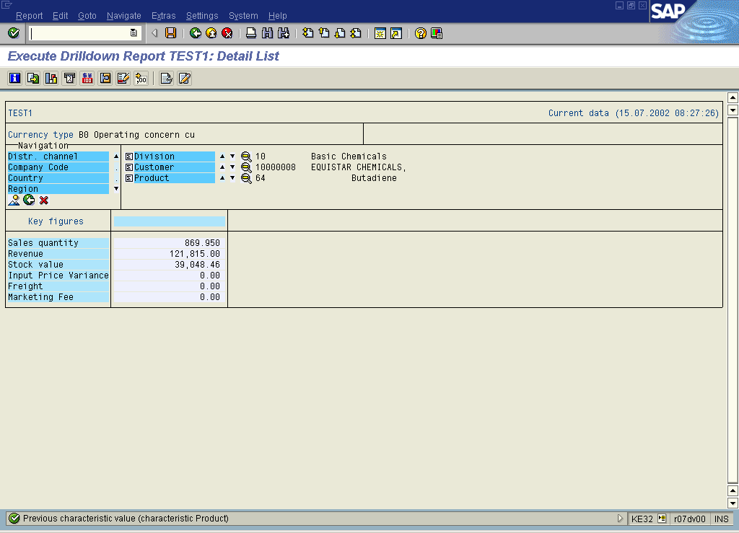



Segments
Notes:
Module name: CO-PA
Course Code: CO PA01
Example of analysis of profitability segments according to SABIC’s characteristics:
Division = Basic Chemicals
Customer = Atlantic Methanol
Product = Butadiene

Slide 22
Table of contents
Course Map
Module 1: Overview
Module 2: Profitability Management
Module 3: Master Data
Module 4: Planning
Module 5: Actual data flow
Module 6: Information System

Slide 23

CO-PA Planning Objectives
Plan Integration
Plan Versions
Creation of a sales plan using planning level and planning packages
Plan Data Transfer

Slide 24
CO-PA Planning Objectives
Plan Integration
Plan Versions
Creation of a sales plan using planning level and planning packages
Plan Data Transfer

Slide 25

Plan Integration
Production
LTP
Production
Notes:
A grp plans at material level in Excel spreadsheets and then upload planning data into the SAP.
In bottom-up planning, plan data can be entered manually for each sales representative and then brought together in a single plan version.
Once planning has been finalized, the plan data can then be transferred over to production planning, thereby allowing production plan data to be reconciled with sales planning.

Slide 26
CO-PA Planning Objectives
Plan Integration
Plan Versions
Creation of a sales plan using planning level and planning packages
Plan Data Transfer

Slide 27
Plan Version ‘0’ SABIC
General Version Definition
Settings for CO-PA
Version
0
Version Locked
0
Plan
B0
Currency type
P
1
Actual
Exchange Rate
P
2
M
The currency type determines the currency or valuation view in which the amounts are to be displayed or planned.
B0 - Operating Concern Currency
Fiscal year dependent
parameters in CO
-
OM
1
Integrated Planning
Plan records are posted
as line items from respective areas.
Controls the exchange rate type, i.e. Buying rate, selling rate or P – Standard translation for planning.
Notes:
Plan version (CO-PA) The version enables you to keep two or more sets of data for the same object. You can maintain and evaluate several plan versions at the same time.
You may wish to have different versions of plan data based, for example, on the type of assumption for the forecast (optimistic, pessimistic), when the plan was created (original plan, updated forecast), how binding the plan is.

Slide 28
CO-PA Planning Objectives
Plan Integration
Plan Versions
Creation of a sales plan using planning level and planning packages
Plan Data Transfer

Slide 29
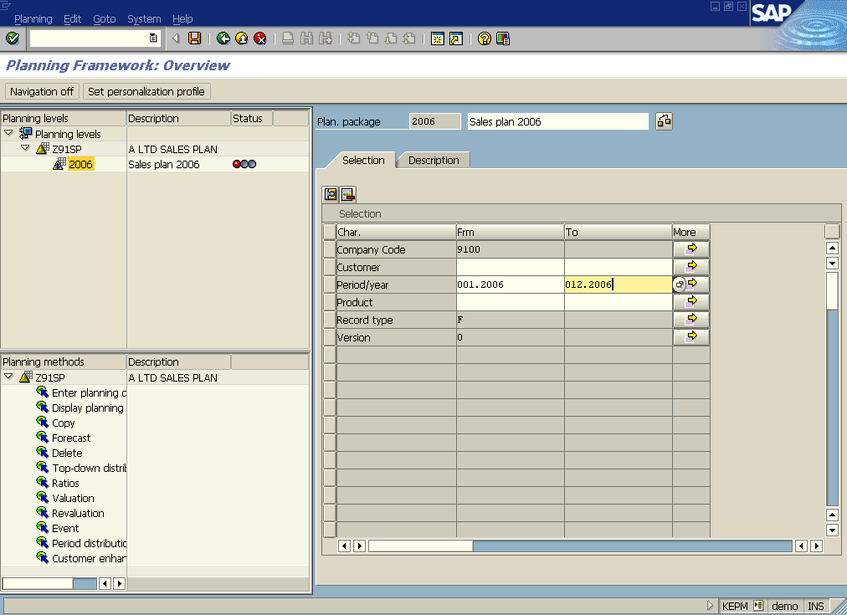
Overview of Planning Framework
Notes:
Taking into account a typical sales and profit planning process, a professional planning tool has to:
Support the individual planning tasks by guiding the user to those planning levels he/she needs to plan. For example, a key account manager needs to plan on the key customer, sales organization and product level.
Support the individual planners by providing personalized access to the desired plan data, using planning packages
Provide a set of relevant planning functions (methods), such as valuations and simulations (forecast, revaluations, etc.) in order to apply the desired planning packages by using planning methods and parameters.
It is possible to plan on many different levels in CO-PA during a planning process. For example, it's possible to plan on the product group level, or the product level, or the customer/product level, or maybe just the customer level. In fact, it is possible to plan on any profitability segment in CO-PA.
By design, the system ensures that the data remains consistent across all levels throughout the planning process, meaning that subtotals will always roll up to totals.
Derivation occurs automatically behind the scenes when planning data is saved. Since this is true, values planned under one or more characteristic values might automatically be summarized under other characteristics as well.

Slide 30
Overview of Planning Framework
Maintain Planning Level-Package-Set-Personalization
Copy Sales Plan
Upload of COPA Plan - Offline Planning
Manual Profit Planning
Valuation Planning Method
Event Planning Method
Period Distribution Planning Method
Ratio Planning Method
Planning Forecast
Revaluation Planning Method

Slide 31
CO-PA Planning Objectives
Plan Integration
Creation of a sales plan using planning level and planning packages
Plan Data Transfer

Slide 32

Plan Data Transfer
Microsoft Excel
Quantities /
Revenue
St
SOP
t
CO
PA
Notes:
Integrated Planning in controlling, where planning is conducted separately for multiple business activities, but the different plans are linked to ensure consistency and to drive realistic corporate-wide planning. Thus, the separate planning results for sales, service, production, procurement, general, and administration activities coincide to form one corporate operational plan.
It is possible to transfer sales plan information back and forth between costing-based Profitability Analysis (CO-PA) and Sales and Operations Planning (SOP). This allows for synchronizing planned sales quantities between these areas.
This flow of planning data is but one example of many possible planning strategies that can be used in R/3. In A Grp integrated planning between CO-PA and PCA is not used but both modules are fed with data from Sales and Profit Plan prepared in Excel spreadsheet.

Slide 33
Table of contents
Course Map
Module 1: Overview
Module 2: Profitability Management
Module 3: Master Data
Module 4: Planning
Module 5: Actual data flow
Module 6: Information System

Slide 34
Actual Values Overview
Flow of Actuals in Profitability Analysis
  Overview
  Flow from the Sales and Distribution (SD) Module
    Flow from Billing Document
  Flow from the FI/MM – direct postings
    General Ledger Posting
    MM Postings
  Flow from the Product Costing
    Settlement of Production Variances to PA

Slide 35
Actual Values Overview
Flow of Actuals in Profitability Analysis
  Overview
  Flow from the Sales and Distribution (SD) Module
    Flow from Billing Document
  Flow from the FI/MM – direct postings
    General Ledger Posting
    MM Postings
  Flow from the Product Costing
    Settlement of Production Variances to PA

Slide 36
Flow of actual values in Profitability Anal.
CO
PA
CO
CO
Profitability Analysis
Profit. segments
Profitability Analysis
Product Cost
Overhead Cost
Product Cost
Overhead Cost
Controlling
Controlling
Controlling
Controlling
•
Cost Centers
Product
Cost Collector
•
Cost Centers
Internal Orders
•
Internal Orders
Standard
Cost Estimate
Cost and Revenue Element Accounting
FI
MM
Revenues
FI
Discounts
SD
SD
Notes:
Actual Postings represent the most important source of information in CO-PA. You transfer billing documents (used in A Grp) from the Sales and Distribution (SD) application component to CO-PA in real time. You can transfer costs (i.e. demurrage costs) and revenues from direct postings (G/L account postings in FI, orders received in MM, and so on) and settle variances from cost objects (production orders) from CO-PC to profitability segments.
In costing-based CO-PA, you can valuate incoming billing documents to automatically determine anticipated sales deductions, costs or even estimated costs, such as Estimated Port Charges. You can also revaluate your data periodically to adjust the initial, real time valuation or add the actual costs of goods manufactured.

Slide 37
Sources of value fields
Value
Source Transaction
Field
Billing Document
Billing Document
Quantity
Revenues
Sales deductions
Cost of Goods Sold
Direct Posting from
FI
Freight costs
Direct Posting from
FI
Inventory re-valuation
Notes:
Using direct postings in FI you can post actual sales reductions, such as annual volume-based rebates, or actual costs, such as freight costs (estimated when the period was closed in order to allow short-term analysis) to the corresponding profitability segments. This supplements the estimated costs with the actual costs.

Slide 38
Actual Values Overview
Flow of Actuals in Profitability Analysis
  Overview
  Flow from the Sales and Distribution (SD) Module
    Flow from Billing Document
  Flow from the FI/MM – direct postings
    General Ledger Posting
    MM Postings
  Flow from the Product Costing
    Settlement of Production Variances to PA

Slide 39
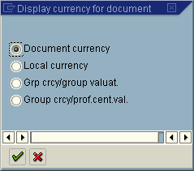
Flow from sales and distribution (1)
NO POSTING
CO
PA
V
V
A
A
L
L
U
U
Inventory Inventory
- Finished Product (FG)
119430
E
F
Stock
F
L
4,975.00-
L
FI
O
FI
O
W
W
Cost of Goods Sold
462002
Change Stock
4,975.00
Business
Goods Issue
process
MM
Notes:
The goods issue is triggered by a delivery in SD. This affects the values in Materials Management and Financial Accounting. Balance sheet and stock change postings are made in FI when the goods issue is posted according to a price in material master.
Note that the goods issue posting does not cause any data to be posted in costing-based CO-PA. The cost of goods sold is only transferred to costing-based CO-PA when the billing document is transferred.

Slide 40
Flow from sales and distribution (2)
CO
PA
V
V
A
A
L
L
U
U
E
FI
Receivables
…
Standard
Price
Cost of Goods
Sold
FI
F
F
L
10,000
+
L
O
Product Cost Estimate
O
W
Sales
810000
W
10,000 -
Business
Sales/
Billing
process
SD
SD
Notes:
The following data is transferred from bills and debit and credit memos to CO-PA.
Revenues
Sales deductions (shipping, discounts, and so on)
Accruals (e.g. from rebate agreements – at first posted in FI)
The cost of goods sold is only transferred to costing-based CO-PA when the billing document is transferred according to a price in material master and a material cost estimate valid on the date of a delivery. This enhancement helps to reconcile COGS posted in FI in a moment of a delivery with COGS posted in CO-PA during billing. It is extremely important while there is a huge time gap between a delivery and a billing.

Slide 41
Actual Values Overview
Flow of Actuals in Profitability Accounting
  Overview
  Flow from the Sales and Distribution (SD) Module
    Flow from Billing Document
  Flow from the FI/MM – direct postings
    General Ledger Posting
    MM Postings
  Flow from the Product Costing
    Settlement of Production Variances to PA

Slide 42

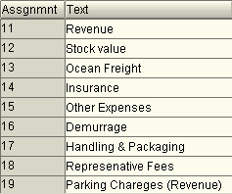

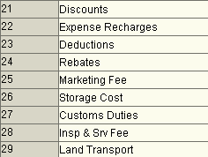


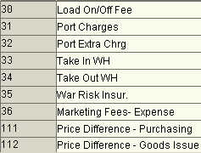


Flow from FI/MM
V
V
A
A
L
L
U
U
E
FI
F
FI
F
L
L
O
O
W
W
CO
PA
Notes:
Using direct postings in FI you can post actual sales reductions, such as annual volume-based rebates, or actual costs, such as demurrage costs (estimated when the period was closed in order to allow short-term analysis) to the corresponding profitability segments. This supplements the estimated costs with the actual costs.
This type of posting will not take place often but can be used to post any type of automatic transaction to CO-PA.
Examples include Inventory Revaluations, I.e. manual with transaction MR21 or with Post Closing step during Material Ledger period-end closing while system uses the periodic unit price that was calculated by the last price determination for the material to revaluate the material stock of the previous period.
The data is posted to a profitability segment found on the basis of the information found in the FI document. If the information there is not very detailed (not many characteristic values), the data is posted to a higher aggregation level.

Slide 43


Flow from FI/MM
CO
PA
V
V
A
A
L
L
U
U
E
FI
Accr. GR/IR
219914
FI
F
F
L
15.00
L
O
O
W
W
Demurrage
&Detention
484013
15.00 -
Notes:
You assign the values to a profitability segment directly in the FI posting transaction. There you can call up a special assignment dialog box for each posting line by clicking the Prof. segment field.
In this dialog box the system displays the characteristics that you can choose from the operating concern you are working in. You can predefine what is displayed on this screen by defining a “characteristic group” for the activity RFBU in Customizing. The characteristic group defines which characteristics are displayed for selection.
System can determine a profitability segment by means of substitution for automatic postings (transaction OKB9). The corresponding posting is then passed on to Profitability Analysis (CO-PA).
Typical business transactions for which a profitability segment is found automatically include:
price differences that are posted in purchasing due to differing order prices or differing prices in invoice receipt (as period costs)
revaluation of material stocks (as period costs) - expenses or revenues.
inventory differences (as period costs)

Slide 44
Actual Values Overview
Flow of Actuals in Profitability Accounting
  Overview
  Flow from the Sales and Distribution (SD) Module
    Flow from Billing Document
  Flow from the FI/MM – direct postings
    General Ledger Postings
    MM Postings
  Flow from the Product Costing
    Settlement of Production Variances to PA

Slide 45




Flow from CO-PC
Goods Issues
of materials from
CO
stock
CO
PC
PC
‘Production Order’
Product Costing
Plan costs
+
Actual costs
...
...
Confirmations/
Delivery
activity allocation
Variances
to stock
Delivery
CO
CO
PC
PC
Calculate
FI
FI
MM
variances
MM
Settlement
CO
PA
Warehouse
Notes:
After finishing the production process (CO production orders), or at the end of the period (product cost collectors), the production order variances will be settled to a price difference account and to CO-PA.

Slide 46










Flow from CO-PC
Variance
Cost Element
Group
PA Assignment
lines
Value Field
Category
+
+
+
Notes:
You can settle (transfer) the production variances calculated in Product Cost Controlling for product cost collectors (settled periodically) and CO production orders to CO-PA. The individual variance categories (such as material price variance, material quantity variance, etc.) are transferred separately.
The PA transfer structure ‘Z9’ consists of items called assignment lines. In these assignment lines you assign a cost element group and a variance category to a value field of the operating concern. To assure correct settlement to Profitability Analysis, you must assign each combination of the cost element group and the variance category to one value field in the operating concern.
Note the following when you use a PA transfer structure:
Every debit cost element must be in the PA transfer structure. You can either group all cost elements into a cost element group or define a number of groups for materials, internal activities, business processes, other overhead costs, etc. These groups are entered under the section “cost elements”.
Every variance category must be represented in the PA transfer structure. The variance categories are specified by the system and are entered under the “source” section.
Each debit cost element or combination of cost element group and variance category can only be assigned to one value field (n:1 relation).
The PA transfer structure ‘Z9’ is assigned to the settlement profile ‘PP01’ which is defaulted for order types: RM01 - PCC for Repetitive Manufacturing, RM02 - PCC for Process Orders and CP01 - Standard CO production order.

Slide 47
Table of contents
Course Map
Module 1: Overview
Module 2: Profitability Management
Module 3: Master Data
Module 4: Actual data flow
Module 5: Planning
Module 6: Information System

Slide 48

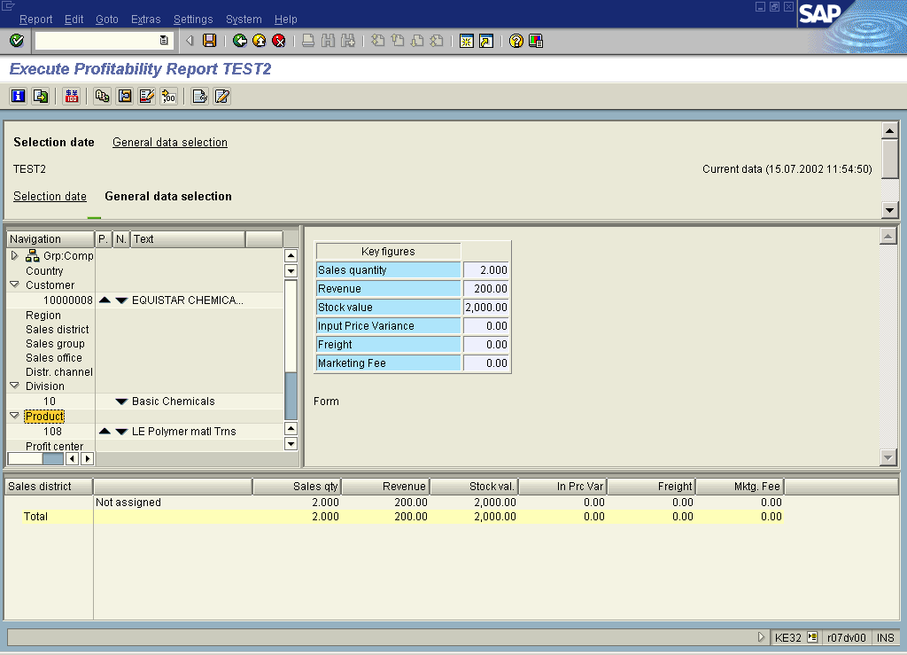
Report Output
Drilldown List
Detail List
Notes:
Module name: CO-PA
Course Code: CO PA01
If you want to execute a report with the output type 'graphical report output', the system displays the same data as with the old list. However, GUI elements are used, which are embedded in a splitter control. This means that the screen is made up of a number of areas, which the user can freely define.
In addition to the more attractive display, a further advantage of this display type is that various functions can be called up using drag and drop. This makes it possible to change the order of columns by marking a column and dragging it to a different position on the screen. It also allows navigation functions, such as drilldown or drilldown switch.

Slide 49
Course Summary
You should now:
Have an understanding the functions in Profitability Analysis.
Understand CO-PA structures and master data.
Identify the source of actual values.
Understand planning.
Use the CO-PA information system.

